Slide 1




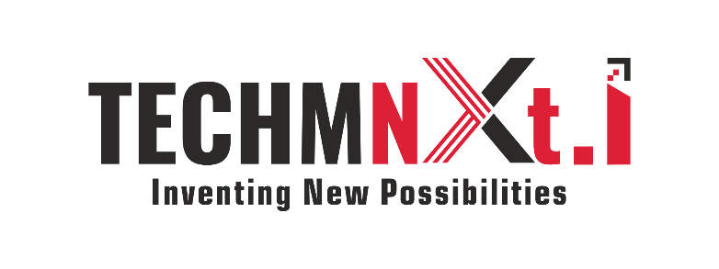
Containerization and AKS
#FuelTheFuture

Slide 2

Agenda
IT Landscape
Virtualization vs Containerization
What is Docker, How it Works?
What is Kubernetes, How it works?
Azure Kubernetes Service
ADO and AKS - DEMO

Slide 3


IT Landscape
DevOps
Cloud
Apps
Migrate Workloads to cloud
Developers:
Freedom to create and deploy apps fast
Define and package application needs independently
IT Operations:
Quickly and flexibly respond to changing needs
Standardize, Secure and manage
80%
Portability across environments
Avoid cloud vendor Lock-in
Loosely Coupled Services
Monolithic
Slow Changing (Minor changes need full re-compile and re-test)
Rapidly Updated
Small Services (Independently Scalable, Stateless, High Availability by design)
Big Servers (Single Point of Failure, scalability?)

Slide 4
Virtualization vs Containerization
Virtualization
Virtualization | Containerization
Represents Hardware Level | Represents Operating System Level
Heavy Weight | Light Weight
Slow Provisioning | Real-time Provisioning and Scalability
Limited Performance | Native Performance
Fully Isolated and Secure | Process Level Isolation, Less Secure
App 1
App 2
Bins/Libs
Bins/Libs
Guest OS
Guest OS
Hypervisior
Host OS
Hardware
Containerization
DB
App
Web Server
Bins/Libs
Bins/Libs
C1
C2
C3
Container Management (Docker)
Host OS
Hardware

Slide 5
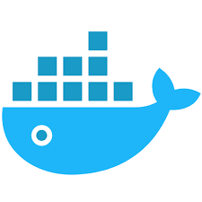
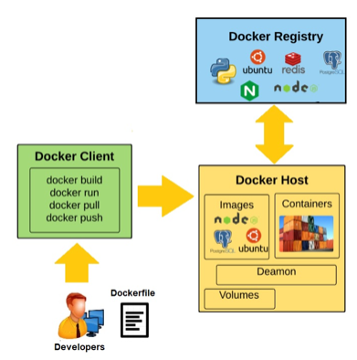
Introduction to Docker
Open source platform that provides tooling to manage lifecycle of containers
Build it Once, run it anywhere (Physical servers, VMs, Diff env)
Resource Efficient
Isolation
Creating, Replicating, Destroying in seconds
Smooth Scaling
Less time consuming to debug, test, deploy – Micro Services/DevOps

Slide 6
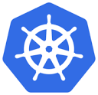
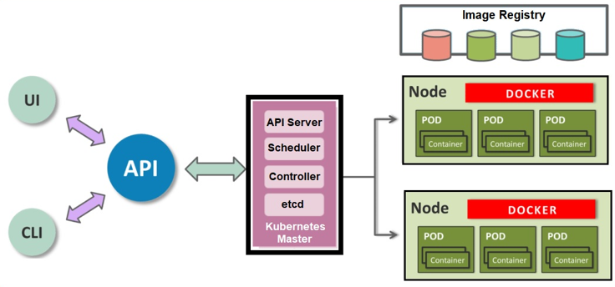
Introduction to Kubernetes?
Open-Source Container Cluster Management/Orchestration tool
Deployment
Scaling
Load balancing
Communication
Managing – What containers run where

Slide 7
Azure Kubernetes Service
Kubernetes as a Service is prominent (Other options are Docker Swarm, Apache Mesos)
Containers have become first class citizens. IaaS is slowly getting moved to CaaS
Un Managed (ACS) vs Managed (AKS)
Un Managed (ACS)
Spin up cluster but leaves management (Patching, Maintaining, Upgrading, Scaling) burden to you
Choose Orchestrator of your choice (Kubernetes, Swarm, Mesosphere DC/CS)
Managed (AKS)
Container hosting solution optimized for Azure
Azure-hosted control pane
Only pay for resource consumption
Automated upgrades, self-healing, easy scaling
Ease Kubernetes management with open source upstream portability

Slide 8
DEMO
Use DevOps Projects to deploy an ASP.NET Core App to AKS
Configure Azure DevOps and an Azure Subscription
Examine AKS Cluster
Examine CI pipeline
Examine CD Pipeline
Commit Changes to Git and automatically deploy them to Azure
Clean up resources

